Slide 1

Docker
Notes:
Just into on why we’re here today and what’s the point of having this presentation. Brifely touch the topic of presenters: SZ, OZ, IL, and KK.
In the end: passing the floot to Sviatlana.

Slide 2
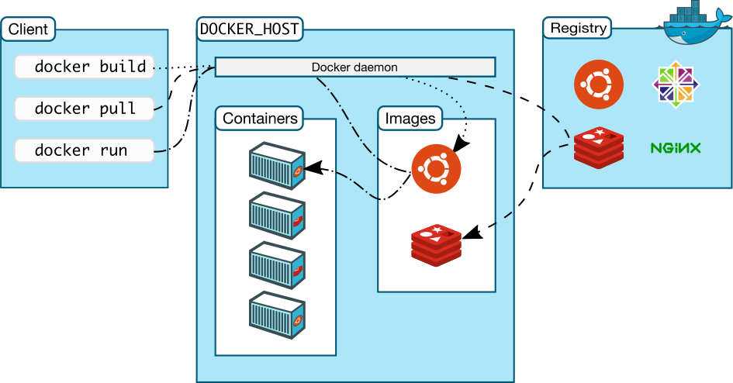
What is docker?
Docker is a software platform that allows you to build, test, and deploy applications quickly.
An image is a read-only template with instructions for creating a Docker container.
A container is a runnable instance of an image. You can create, start, stop, move, or delete a container using the Docker API or CLI
A registry is a storage and distribution system for named Docker images. The same image might have multiple different versions, identified by their tags.
Docker daemon is a process that runs on host and controls containers.

Slide 3
How to run a simple container?
docker run <options> <image-name>
docker run –p 8080:80 nginx

Slide 4
Demo time!

Slide 5
Docker advantages
Consistent and Isolated Environment – containers are isolated from each other better that simple processes in OS. Containers are platform independent, so you can run the same image on Linux and Windows. Only processor architecture matters, but x86 architecture is far the most popular nowadays.
Lightweight – containers use less resources than Virtual Machines. Single host can run tens of containers simultaneously. Containers have small overhead and start up fast
Faster development – using docker it’s easier to run applications locally. It’s easier to build and run them

Slide 6
Docker vs VM
App 1
App 2
App 3
App 1
App 2
App 3
Guest OS
Guest OS
Guest OS
Container Engine
Hypervisor
OS
Host
Host
Virtualization
Containerization

Slide 7
Demo time!

Slide 8
Docker commands
docker ps – view all running containers. Other containers and their info can be shown using command flags
docker kill <id> – stops the container
docker exec <id> – exec command inside container
docker exec –it <id> /bin/bash – enter container shell
docker run –e A=1 <image> – set env variable for container
docker run --memory=100m --cpus=1 <image> - set resource limits for container

Slide 9
Dockerfile
Dockerfile example:
FROM ubuntu:18.04 # define base image and version
COPY . /app # copy files from current folder to /app folder
RUN make /app # build application
CMD python /app/app.py # run application

Slide 10
Docker Layers
47f5d25d
Application layers
3d632e2e
90157b3d
90157b3d
69650296
69650296
Base Linux image
Base Linux image
bea46d7a
bea46d7a
2af5e674
2af5e674

Slide 11
Demo time!

Slide 12
Build command
To build a docker image run:
docker build -t demo -f Dockerfile .
-t demo – tag. It‘s used to run your image later
-f Dockerfile – your docker file. Name can be any, usually has a Dockerfile prefix
. – path to the directory in which you build the image. In this case, image is built in current dir

Slide 13

Docker Compose
Docker Compose – is software used for defining and running multi-container Docker applications.
Docker Compose benefits:
Fast and simple configuration
Secure internal communication
Portability and CI/CD support
Efficient use of resources
Docker Compose is configured with docker-compose.yaml file.
Docker Compose commands:
docker compose up
docker compose down

Slide 14
Demo time!

Slide 15
QA
Do you have any questions?

